Slide 1
IT694 Computer Networks
Week8_Lec3_Router Internals

Slide 2
Switching fabrics
transfer packet from input link to appropriate output link
switching rate: rate at which packets can be transfer from inputs to outputs
often measured as multiple of input/output line rate
N inputs: switching rate N times line rate desirable
R
(rate: NR, ideally)
R
. . .
high-speed
switching
fabric
. . .
N input ports
N output ports
R
R

Slide 3
Switching fabrics
transfer packet from input link to appropriate output link
switching rate: rate at which packets can be transfer from inputs to outputs
often measured as multiple of input/output line rate
N inputs: switching rate N times line rate desirable
three major types of switching fabrics:
memory
memory
bus
interconnection
network

Slide 4
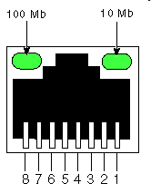
Switching via memory
first generation routers:
traditional computers with switching under direct control of CPU
packet copied to system’s memory
speed limited by memory bandwidth
input
port
(e.g.,
Ethernet)
output
port
(e.g.,
Ethernet)
memory
system bus

Slide 5
Switching via a bus
datagram from input port memory to output port memory via a shared bus
Append with label indicating Output Port
Appropriate port responds
bus contention: switching speed limited by bus bandwidth
32 Gbps bus, Cisco 5600: sufficient speed for access routers

Slide 6
Switching via interconnection network
Crossbar, Clos networks, other interconnection nets initially developed to connect processors in multiprocessor
3x3 crossbar
multistage switch: nxn switch from multiple stages of smaller switches
3x3 crossbar
exploiting parallelism:
fragment datagram into fixed length cells on entry
switch cells through the fabric, reassemble datagram at exit
N x N switching elements
allows N simultaneous packets switched (in the best case when all packets going to different outputs)

Slide 7
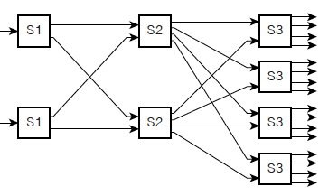
Switching via interconnection network
scaling, using multiple switching “planes” in parallel:
speedup, scaleup via parallelism
Cisco CRS router:
basic unit: 8 switching planes
each plane: 3-stage interconnection network
up to 100’s Tbps switching capacity
fabric plane 0
fabric plane 1
fabric plane 2
. . .
. . .
fabric plane 3
. . .
. . .
fabric plane 4
. . .
. . .
fabric plane 5
. . .
. . .
fabric plane 6
. . .
. . .
fabric plane 7
. . .
. . .
. . .
. . .
. . .
. . .

Slide 8
Output port queuing
datagram
buffer
queueing
switch
fabric
(rate: NR)
link
layer
protocol
(send)
line
termination
R
Buffering required when datagrams arrive from fabric faster than link transmission rate. Drop policy: which datagrams to drop if no free buffers?
Datagrams can be lost due to congestion, lack of buffers
Scheduling discipline chooses among queued datagrams for transmission
Priority scheduling – who gets best performance, network neutrality

Slide 9
Output port queuing
switch
fabric
switch
fabric
at t, packets more
from input to output
one packet time later
buffering when arrival rate via switch exceeds output line speed
queueing (delay) and loss due to output port buffer overflow!

